Slide 1
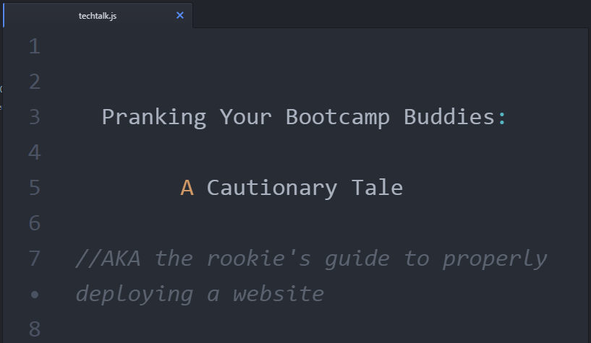
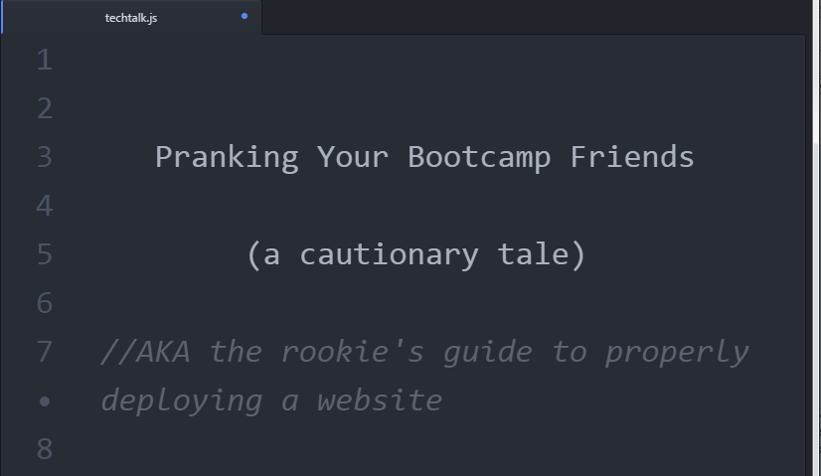
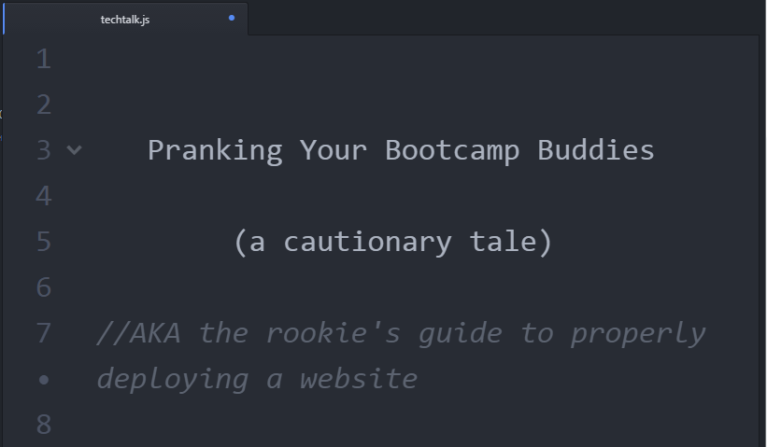
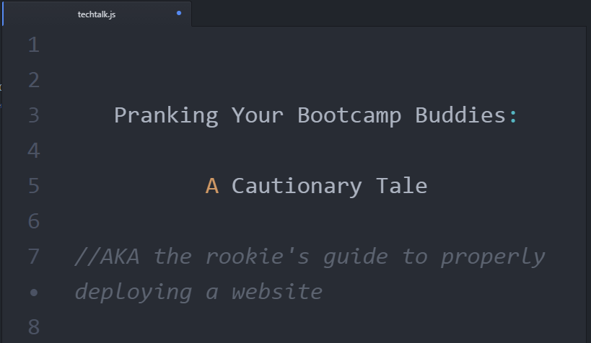
Notes:
This is a tale that involves domains, web hosting, office pranks, and how not to do what I did

Slide 2


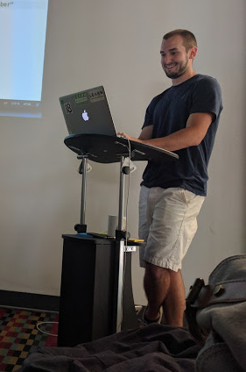

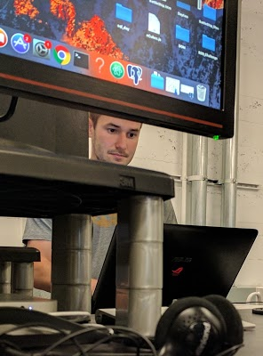
Meet Nick
Don’t even
think about buying
nickbouldien.com
Nobody buy nickbouldien.com, that’s mine
Nobody buy nickbouldien.com, I’m serious
Notes:
So, first of all, I gotta say Nick is a really good sport. He’s been the subject of several bootcamp jokes already, like nick pics, so when he repeatedly said “nobody buy nickbouldien.com, that’s mine”, we knew what we had to do

Slide 3

Notes:
So, first of all, I gotta say Nick is a really good sport. He’s been the subject of several bootcamp jokes already, like nick pics, so when he repeatedly said “nobody buy nickbouldien.com, that’s mine”, we knew what we had to do

Slide 4
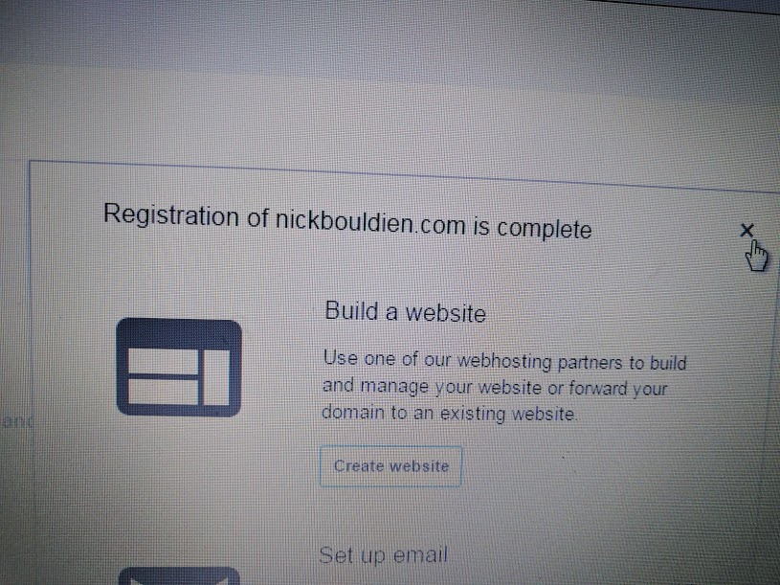

SUCCESS!!!
Notes:
So, first of all, I gotta say Nick is a really good sport. He’s been the subject of several bootcamp jokes already, like nick pics, so when he repeatedly said “nobody buy nickbouldien.com, that’s mine”, we knew what we had to do

Slide 5
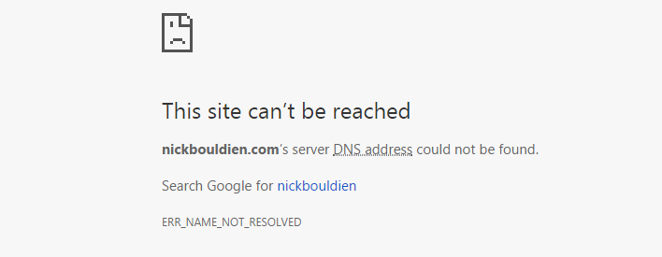

SUCCESS!!!
wait… what??
Notes:
So, first of all, I gotta say Nick is a really good sport. He’s been the subject of several bootcamp jokes already, like nick pics, so when he repeatedly said “nobody buy nickbouldien.com, that’s mine”, we knew what we had to do

Slide 6


how websites work
web host service
domain

Slide 7


how websites work
web host service

Slide 8
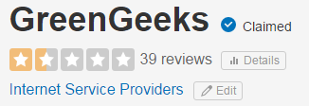
Nick found out
LIES

Slide 9

Lessons Learned
To deploy a website with a custom domain, you need...
Web Host
Custom Domain Name
Best to acquire domain and web hosting separately
in case one goes down
Read the fine print... or at least check Yelp
so you don’t end up like me
Github Pages offers free hosting
my #1 recommendation

Slide 10
helpful links
Getting Started with Github Pages
Amazon Domain Registration Pricing
Github Quick Start: Setting Up a Custom Domain
Questions to Ask Before Buying Web Hosting

Slide 11

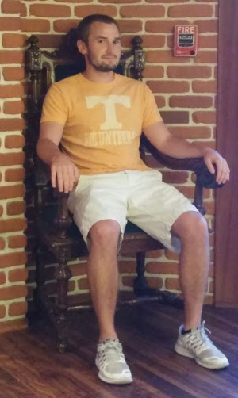


Thank you!
Thoughts? Questions? Concerns?
@rathelina
linkedin.com/in/rachelruderman
github.com/rachelruderman
also check out nickbouldien.com, it’s now live!

Slide 12
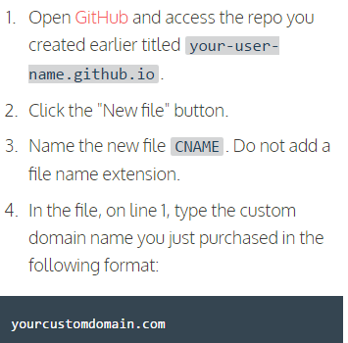
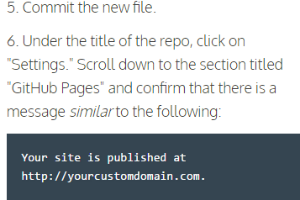
Notes:
: (the mission was simple. It was a 3-part plan)
Audience participation: was nick a good choice? would you prank nick? How so¿

Slide 13
helpful links
https://help.github.com/articles/quick-start-setting-up-a-custom-domain/
.sucks ($282)
.movie ($306)
.gold ($101)
Succesfully used GitHub Pages to deploy your site to the Internet!
Purchase a custom domain name: Google domains (5 day return), amazon web servicesBefore you choose a custom domain name, it's important to first understand what domain names actually are.
Domain names are human-friendly names that identify servers on the Internet. A global system known as the Domain Name System (DNS) is used for storing which domain names correspond to which servers.
https://d32ze2gidvkk54.cloudfront.net/Amazon_Route_53_Domain_Registration_Pricing_20140731.pdf
$12 for .com
The suffixes of domain names are known as top-level domains (TLDs). Different TLDs cost different annual prices.
He said multiple times for nobody to buy it
Audience participation: was nick a good choice? would you prank nick? How so¿

